Slide 1

Minor Project
Sentiment Analysis on
Product reviews using machine learning
Guided By:
Prof. Manish Pandey
Isha Jain : 191112220
Reetu Raj : 191112239
Mayank Jaiswal : 191112225
Palak Meena : 191112223

Slide 2
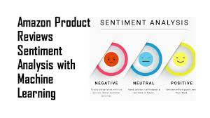
INTRODUCTION
The advent of electronic commerce with growth in internet and network technologies has led customers to move to online retail platforms such as Amazon, Walmart, Nykaa etc. People often rely on customer reviews of products before they buy online.These reviews are often rich in information describing the product.
Customers often choose to compare between
various products and brands based on whether an
item has a positive or negative review.
More often, these reviews act as a feedback
mechanism for the seller. Through this medium,
sellers strategize their future sales and product
improvement.

Slide 3
What is Sentimental Analysis?
Machine Learning models take numerical values as input. The reviews are made of sentences, so in order to extract patterns from the data; we need to find a way to represent it in a way that a machine learning algorithm can understand, i.e. as a list of numbers.
Sentiment analysis or opinion mining is one of the major tasks of NLP (Natural Language Processing) that has gained much attention in recent years. The sentiment is a feeling, expression, thought, or judgment, and using sentiment analysis one can study the target audience’s sentiments towards an entity. It’s a form of text analysis that senses polarity (e.g. a positive or negative opinion) within the whole text, sentence, paragraph or phrase.

Slide 4
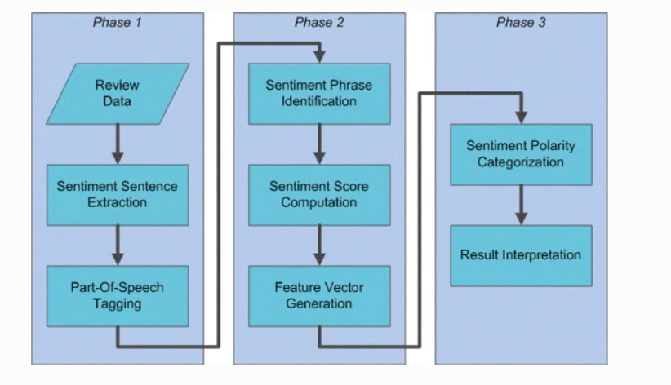
Sentimental Analysis

Slide 5
Why should people and companies use our website?
In today’s retail marketing world, there are so many new products emerging every day. Therefore, customers need to rely largely on product reviews to make up their minds for better decision making on purchase. However, searching and comparing text reviews can be frustrating for users. Hence we need a better numerical ratings system based on the reviews which will make customers purchase decisions with ease.
During their decision making process, consumers want to find useful reviews as quickly as possible using a rating system. Therefore, models able to predict the user rating from the text review are critically important. Getting an overall sense of a textual review could in turn improve consumer experience. Also, it can help businesses to increase sales, and improve the product by understanding customer’s needs.

Slide 6
Gaps Identified
It is a very tedious process for a customer to read 100+ reviews while buying any online product.
And many times people skip reading the reviews and hence lose their money by buying big costly appliances or sometimes in the case of beauty products they get reactions.
The already existing star rating system is not very apt as many people don't mark it and it gets difficult to judge any product on its basis.
The ratings will be done automatically based on the review and the person won't have to spend time marking stars.
Also the wide marketing done these days of every product often tricks customers to buy a product .
Even the seller doesn't want to spend time reading individual reviews hence our app will help them as well by giving combined reviews in a more precise and easy to understand manner.

Slide 7
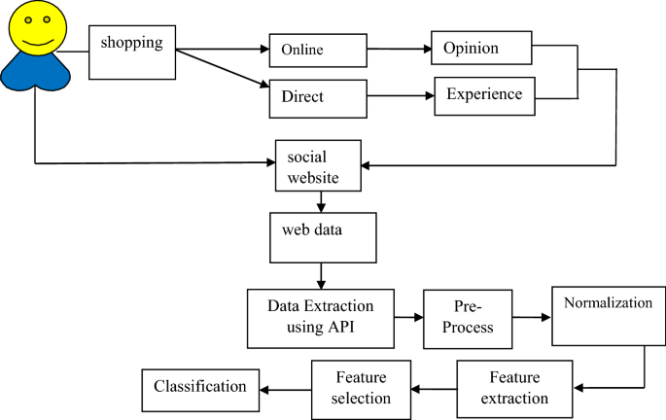
Proposed Work and Methodology

Slide 8
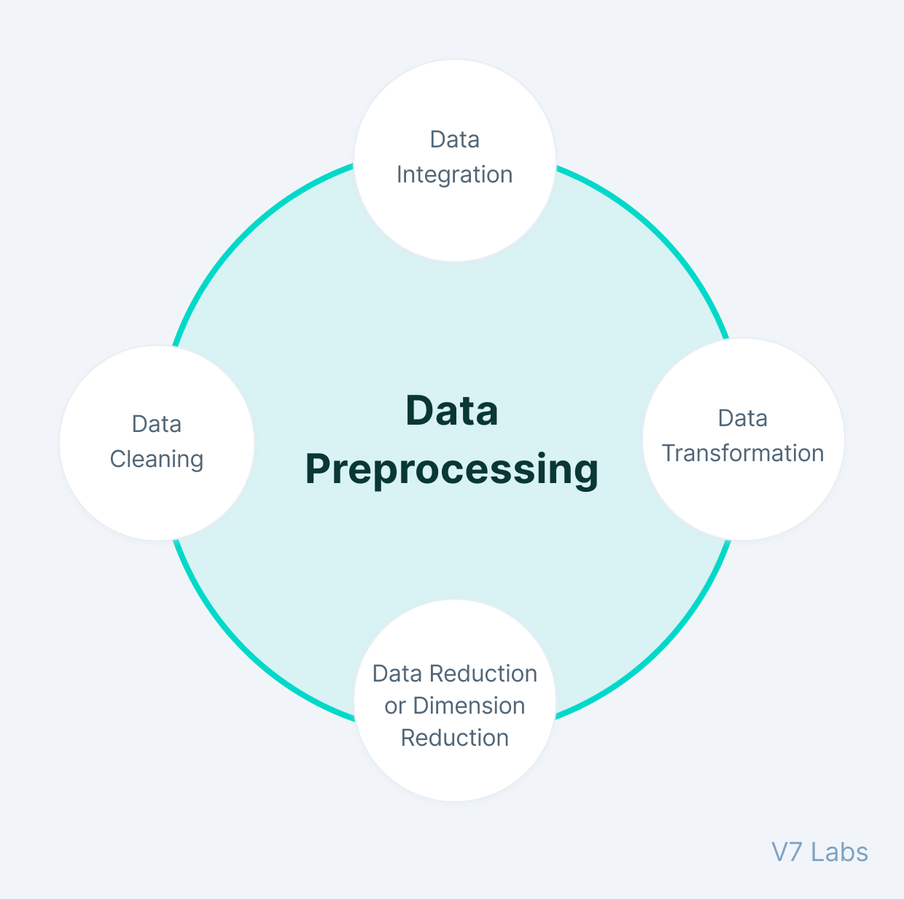
Preprocessing Text

Slide 9
Machine learning models tested
Naive Bayes
Logistic Regression
Random Forest
Decision Tree
Support Vector Machine

Slide 10
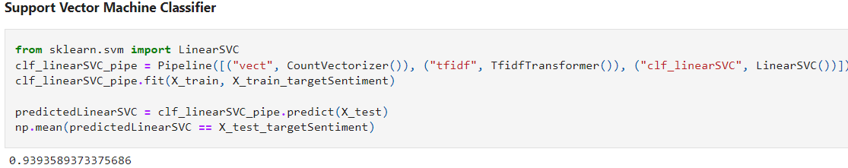
SVM Model
Sentiment Analysis is the NLP technique that performs on the text to determine whether the author’s intentions towards a particular topic, product, etc. are positive, negative.
Out of all the models SVM model gave the highest accuracy,so we finally chose that.

Slide 11
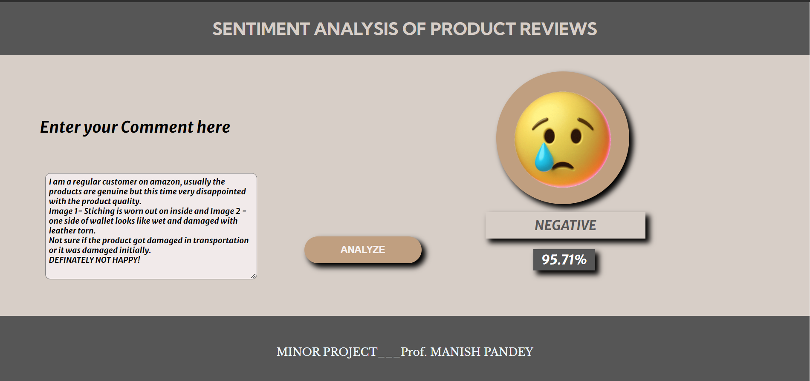
Outputs generated by our website
I am a regular customer on amazon, usually the products are genuine but this time very disappointed with the product quality.
Image 1- Stiching is worn out on inside and Image 2 - one side of wallet looks like wet and damaged with leather torn.
Not sure if the product got damaged in transportation or it was damaged initially.
DEFINITELY NOT HAPPY!

Slide 12
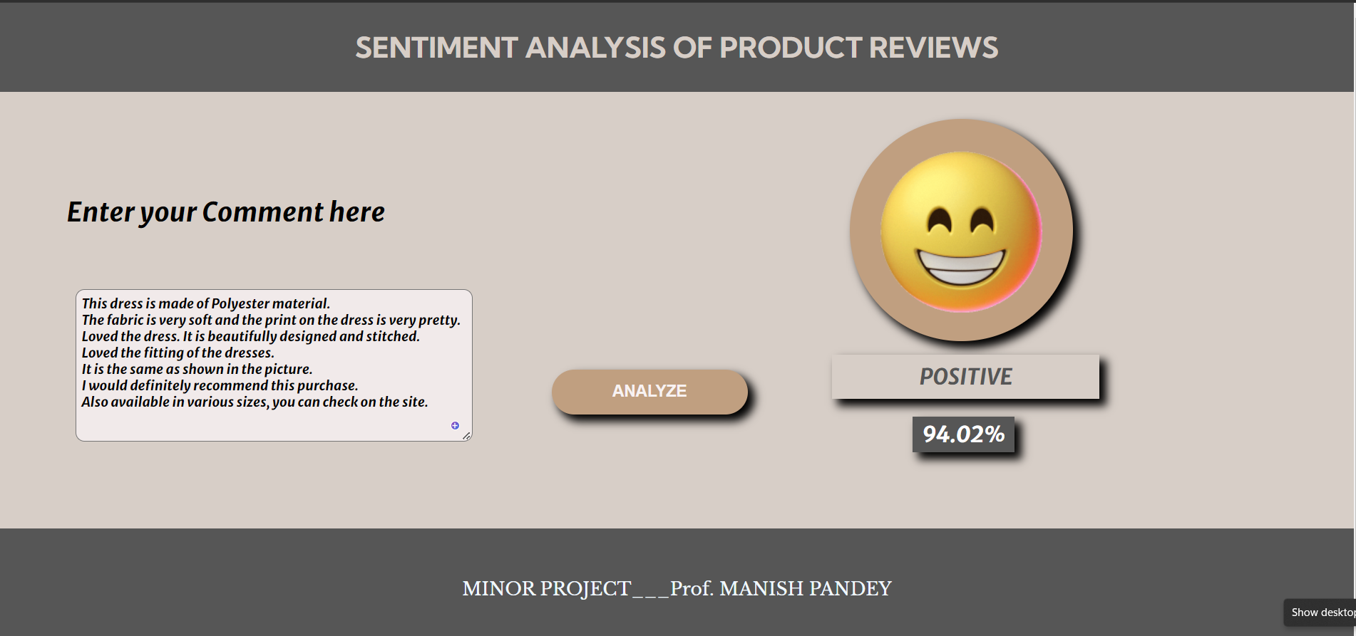
Outputs generated by our website
This dress is made of Polyester material. The fabric is very soft and the print on the dress is very pretty. Loved the dress. It is beautifully designed and stitched. Loved the fitting of the dress. It is the same as shown in the picture. I would definitely recommend this purchase.

Slide 13
So let’s see a live demonstration now !!

Slide 14
Conclusion
This Study Report finally concludes that, how Sentiment analysis would work for product review analysis on online websites.We made a generalised project for all types of products analysis.
An evolutionary shift from offline markets to digital markets has increased the dependency of customers on online reviews to a great extent. Online reviews have become a platform for building trust and influencing consumer buying patterns. With such dependency there is a need to handle such a large volume of reviews and present credible reviews before the consumer. Our research is aiming to achieve this by conducting sentiment analysis of reviews and classifying the reviews into positive and negative sentiment.

Slide 15
Thanks ;)

